Slide 1
Huffman coding

Slide 2
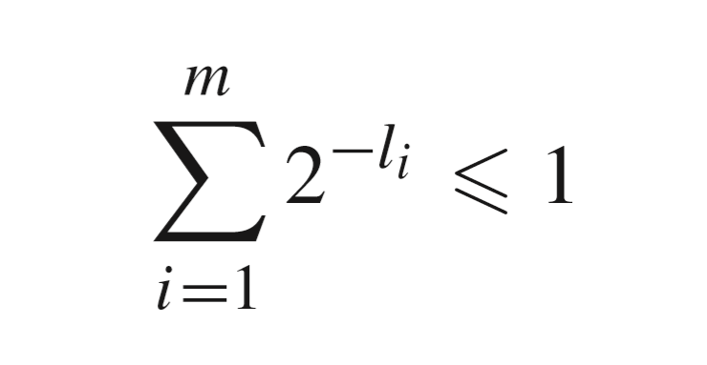
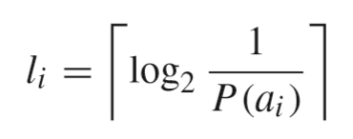
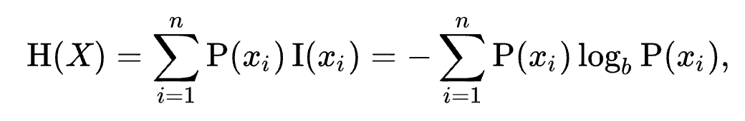


The basics
Entropy
Kraft-McMillan inequality
$$H\left(x\right)=E\left(I\left(x\right)\right),$$
$$where I\left(x\right)=\log_{2}⁡(\frac{1}{P\left(x\right)})$$

Slide 3
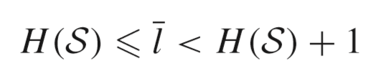
Huffman coding
Symbols more frequently seen have shorter code words.
2. The two symbols occurring least frequently have the same length.
Implementation:
Tree vs Table
Minimal difference
Optimality
design

Slide 4
Distortion
Canonical
Length-limit
Non-binary
With constraint added

Slide 5
2n-1 nodes
Not optimum
One-pass
Adaptive coding

Slide 6
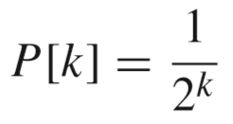
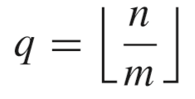

golomb & rice, Tunstall codes
Golomb codes
Rice codes
Tunstall codes
Basically are Golomb codes but work on a string of data instead of a list of integers
Usually J, m are of the power of 2
Fixed length, but may decode to more than one symbol.
Shares the same idea of Huffman codes

Slide 7
Text compression
Image compression
Audio compression
applications

Slide 8
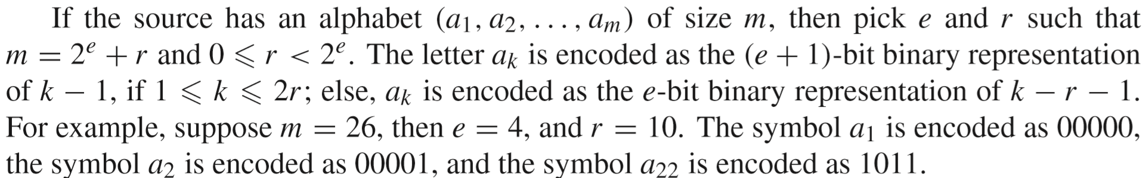
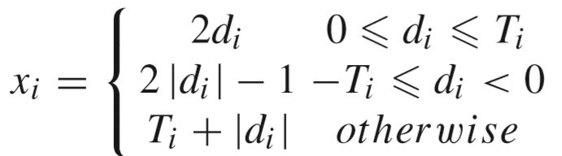
Hey, wait! What is this?
Why 00000 instead of 0?
What is x?(p.77)

Slide 9
end

